Slide 1


Predictive Modeling for Heart Disease Diagnosis Using Machine Learning
•Authors: Ramiz, Jalil, Parviz, Rashad, Xanahmad
•Institution: Khazar University, Computer Science
•Date: 05/28/2025
Notes:
1

Slide 2

Introduction
Key Points
Cardiovascular diseases are the leading cause of global mortality.
Early diagnosis is crucial for effective treatment.
Machine learning can assist clinicians in identifying high-risk patients.
Objective: Build and evaluate ML models for binary classification of heart disease.
Notes:
2

Slide 3

Dataset & Preprocessing
UCI Heart Disease dataset used (303 instances, 14 features).
Missing values in 'ca' and 'thal' filled using mode.
Features scaled using StandardScaler.
Target: Presence (1) or absence (0) of heart disease.
Notes:
3

Slide 4
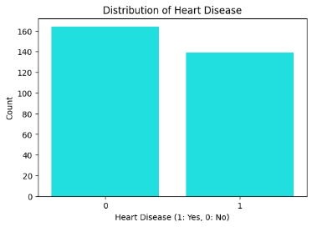
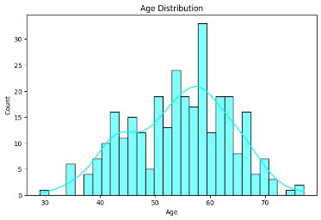
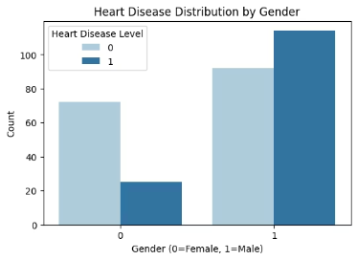
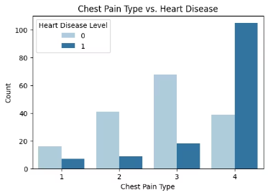
Visualizations
Distribution of classes
Age distribution
Disease distribution by gender
Heart disease by chest pain type
Notes:
4

Slide 5
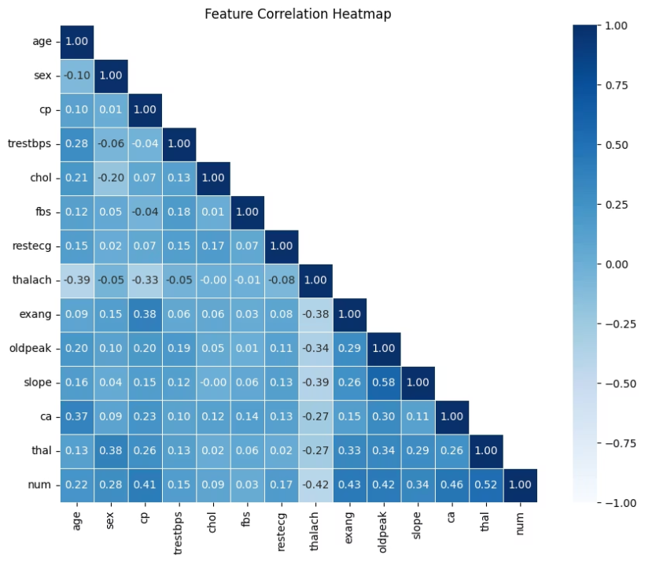
Correlation Heatmap of Heart Disease Features
This Feature Correlation Heatmap shows relationships between various health metrics:
Strong positive correlations appear between 'num' and several features ('thal' : 0.52, 'ca' : 0.46)
Notes:
5

Slide 6

Methodology
(Part 1)
- Models used: Logistic Regression, Random Forest, SVC, KNN.
- Stratified K-Fold Cross-Validation (k=5) applied for balanced evaluation.
- GridSearchCV used for hyperparameter tuning.
- ROC AUC, Precision, Recall used as a key metric.
Notes:
6

Slide 7
Methodology
(Part 2)
- Evaluation Metrics: Accuracy, Precision, Recall, F1-score, ROC AUC.
- ROC AUC emphasized due to clinical importance of minimizing false negatives.
- Confusion matrices used to interpret model behavior.
Notes:
7

Slide 8
Results Overview
Model
ROC AUC
Precision
Recall
F1-Score
Accuracy
KNN
0.94
0.94
0.91
0.92
0.918
Random Forest
0.94
0.96
0.84
0.90
0.902
SVC
0.93
0.93
0.88
0.90
0.902
Logistic Regression
0.94
0.88
0.91
0.89
0.885
Logistic Regression : High recall, interpretable.
Random Forest : High precision, robust to overfitting.
SVC : Balanced and effective with proper scaling.
KNN : Highest accuracy, sensitive to feature scaling.
Notes:
8

Slide 9

Real-World Application
Logistic Regression in clinics needing transparency.
KNN or SVC where slight accuracy gains are critical.
Random Forest in automated pipelines with large datasets.
Notes:
9

Slide 10
Conclusion
1
Multiple models reached AUC > 0.93, confirming feasibility.
2
KNN had the best accuracy; Random Forest had top precision.
3
Stratified K-Fold ensured robust validation.
4
Future work: use more diverse datasets, add clinical variables.
Notes:
10

Slide 11
Thank You for Your Attention.
Notes:
11

